Slide 1
Perl
Dr.G.Malathi
Associate Professor, SCSE
VIT University

Slide 2
Introduction to PERL (Practical Extraction and Report Language.)
Perl is a general-purpose programming language.
Developed for text manipulation.
A Perl script can be created inside of any normal simple-text editor program.
a Perl file must be saved with a .pl or .PL

Slide 3
Introduction
general-purpose programming language
web development, network programming, GUI development.
Practical Extraction and Report Language.
Supports both procedural and object-oriented programming.

Slide 4
Why Perl
popular web programming language
text manipulation capabilities
rapid development cycle.

Slide 5
Simple Statement
print("Hello, world\n");
# to comment
For documentation
=Begin
Lines then end with
=

Slide 6
Quotes
Double quotes can be interpolated
$a = 10; print "Value of a = $a\n";
Output:
Value of a = 10

Slide 7
Single Quotes
$a = 10;
print 'Value of a = $a\n';
Output:
Value of a = $a\n$

Slide 8
Example – Double Quotes
$a = 10; $var = <<"EOF";
This is the syntax for here document and it will continue until it encounters a EOF in the first line. a = $a EOF print "$var\n";
Output:
This is the syntax for here document and it will continue until it encounters a EOF in the first line. a = 10

Slide 9
Example – Single Quotes
var = <<'EOF'; This is case of single quote so variable value will not be interpolated. For example value of a = $a EOF print "$var\n";
Output:
This is case of single quote so variable value will be interpolated. For example value of a = $a

Slide 10
Escaping Characters
$result = "This is \"number\"";
print "$result\n";
Output:
This is "number"

Slide 11
Identifiers
Perl identifier is a name used to identify a variable, function, class, module, or other object.
A Perl variable name starts with either $, @ or % followed by zero or more letters, underscores, and digits (0 to 9).
case sensitive programming language

Slide 12
A Perl identifier is a name used to identify a variable, function, class, module, or other object.
A Perl variable name starts with either $, @ or % followed by zero or more letters, underscores, and digits (0 to 9).
does not allow punctuation characters such as @, $, and % within identifiers.
Perl is a case sensitive programming language

Slide 13
Perl – Data Types
Perl is a loosely typed language.
will choose the type based on the context of the data itself.
Perl has three basic data types:
scalars,
arrays of scalars,
and hashes of scalars, also known as associative arrays.

Slide 14
Scalar Data Type
Scalars are simple variables.
If you treat the variable as character then it can store a character.
If you treat it as a number it can store one number.
Eg $name = "betty" ;
The value betty is stored in the scalar variable $name.
Default values for all variables is undef.

Slide 15
List Variables
They are like arrays. It can be considered as a group of scalar variables.
They are always preceded by the @symbol.
Eg @names = ("betty","veronica","tom");
Like in C the index starts from 0.

Slide 16
List Variables
If you want the second name you should use $names[1] ;
$ Followed by the listvariable gives the length of the list variable.
Eg $names here will give you the value 3.

Slide 17
Types of Variables
Types of variables:
Scalar variables : $a, $b, $c
Array variables : @array
Hash variables : %hash
File handles : STDIN, STDOUT, STDERR
Variables do not need to be declared
Variable type (int, char, ...) is decided at run time
$a = 5; # now an integer
$a = “perl”; # now a string

Slide 18
Equality Operators for Strings
Equality/ Inequality : eq and ne
$language = “Perl”;
if ($language == “Perl”) ... # Wrong!
if ($language eq “Perl”) ... #Correct
Use eq / ne rather than == / != for strings

Slide 19
Relational Operators for Strings
Greater than
Numeric : > String : gt
Greater than or equal to
Numeric : >= String : ge
Less than
Numeric : < String : lt
Less than or equal to
Numeric : <= String : le

Slide 20
String Functions
Convert to upper case
$name = uc($name);
Convert only the first char to upper case
$name = ucfirst($name);
Convert to lower case
$name = lc($name);
Convert only the first char to lower case
$name = lcfirst($name);

Slide 21
If ... else ... statements
if ( $weather eq “Rain” )
{
print “Umbrella!\n”;
}
elsif ( $weather eq “Sun” ) {
print “Sunglasses!\n”;
}
else {
print “Anti Radiation Armor!\n”;
}

Slide 22
Unless ... else Statements
Unless Statements are the opposite of if ... else statements.
unless ($weather eq “Rain”) {
print “Dress as you wish!\n”;
}
else {
print “Umbrella!\n”;
}
And again remember the braces are required!

Slide 23
While Loop
Example :
$i = 0;
while ( $i <= 1000 ) {
print “$i\n”;
$i++;
}

Slide 24
Until Loop
The until function evaluates an expression repeatedly until a specific condition is met.
Example:
$i = 0;
until ($i == 1000) {
print “$i\n”;
$i++;
}

Slide 25
For Loops
Syntax 1:
for ( $i = 0; $i <= 1000; $i=$i+2 ) {
print “$i\n”;
}
Syntax 2:
for $i(0..1000) {
print “$i\n”;
}

Slide 26
Moving around in a Loop
next: ignore the current iteration
last: terminates the loop.
What is the output for the following code snippet:
for ( $i = 0; $i < 10; $i++) {
if ($i == 1 || $i == 3) { next; }
elsif($i == 5) { last; }
else
{print “$i\n”;}
}

Slide 27
Arrays
@ages = (25, 30, 40);
print "\$ages[0] = $ages[0]\n";
print "\$ages[1] = $ages[1]\n";
print "\$ages[2] = $ages[2]\n";
Output:
$ages[0] = 25
$ages[1] = 30
$ages[2] = 40

Slide 28
Push,pop,shift,Unshift,reverse
These are operators operating on the list variables.
Push and pop treat the list variable as a stack and operate on it. They act on the higher subscript.
Eg push(@names,"lily") , now the @names will contain ("betty","veronica","tom","lily").

Slide 29
Push,pop,shift,Unshift,reverse
Eg pop(@names) will return "lily" which is the last value. And @names will contain ("betty","veronica","tom").
Reverse reverses the list and returns it.

Slide 30
Hashes,keys,values,each
Hashes are like arrays but instead of having numbers as their index they can have any scalars as index.
Hashes are preceded by a % symbol.
Eg we can have %rollnumbers = ("A",1,"B",2,"C",3);

Slide 31
Hashes,keys,values,each
If we want to get the rollnumber of A we have to say $rollnumbers{"a"}. This will return the value of rollnumber of A.
Here A is called the key and the 1 is called its value.
Keys() returns a list of all the keys of the given hash.
Values returns the list of all the values in a given hash.

Slide 32
%data = (‘Dev', 45, ‘Manu', 30, ‘Suji', 40);
print "\$data{‘Manu '} = $data{‘Manu '}\n";
Output:
$data{' Manu '} = 30

Slide 33
Read / Write to Files
To read and write to files we should create something called handles which refer to the files.
To create the handles we use the OPEN command.
Eg open(filehandle1,"filename"); Will create the handle called FILEHANDLE1 for the file "filename".
This handle will be used for reading.

Slide 34
Read/Write to files
Eg open(filehandle2,">filename"); Will create the handle called FILEHANDLE2 for the file "filename".
This handle will be used for writing.
Watch out for the ">" symbol before the filename. This indicates that the file is opened for writing.

Slide 35
Read/Write to files
Eg $linevalue = <FILEHANDLE1> ;
This will result in a line being read from the file pointed by the filehandle and the that line is stored in the scalar variable $linevalue.
When the end of file is reached the <FILEHANDLE1> returns a undef.
Eg print FILEHANDLE2 "$linevalue\n";

Slide 36
Read/Write to files
This will result in a line with the value as in $linevalue being written to the file pointed by the filehandle2 .
For closing a filehandle use close(FILEHANDLE);

Slide 37
Control Structures
1. if(boolean_expression)
{ # statement(s) will execute if the given condition is true }
2. if(boolean_expression)
{ # statement(s) will execute if the given condition is true }
Else
{ # statement(s) will execute if the given condition is false }

Slide 38
An if can have zero or one else's and it must come after any elsif's.
if(boolean_expression 1)
{ # Executes when the boolean expression 1 is true }
elsif( boolean_expression 2)
{ # Executes when the boolean expression 2 is true }
elsif( boolean_expression 3)
{ # Executes when the boolean expression 3 is true }
Else
{ # Executes when the none of the above condition is true }

Slide 39
If the boolean expression evaluates to false, then the block of code inside the unless statement will be executed.
If boolean expression evaluates to true then the first set of code after the end of the unless statement (after the closing curly brace) will be executed.
unless(boolean_expression)
{ # statement(s) will execute if the given condition is false }

Slide 40
unless(boolean_expression)
{ # statement(s) will execute if the given condition is false }
Else
{ # statement(s) will execute if the given condition is true }

Slide 41
Switch Statement
$var = 10;
@array = (10, 20, 30);
%hash = ('key1' => 10, 'key2' => 20);
switch($var)
{ case 10 { print "number 100\n" }
case "a" { print "string a" }
case [1..10,42] { print "number in list" }
case (\@array) { print "number in list" }
case (\%hash) { print "entry in hash" }
else { print "previous case not true" }
}

Slide 42
Loop statements
while(condition)
{ statement(s);
}
Stops iteration when the condition becomes false.

Slide 43
Until (condition)
{ statement(s); }
Iterates only when the condition is false.

Slide 44
For statement
for ( init; condition; increment )
{ statement(s); }

Slide 45
Foreach loop
The foreach loop iterates over a list value and sets the control variable (var) to be each element of the list in turn
@list = (2, 20, 30, 40, 50);
# foreach loop execution
foreach $a (@list)
{ print "value of a: $a\n"; }

Slide 46
Do while
This process repeats until the given condition becomes false.
do {
statement(s);
}
while( condition );

Slide 47
Array Operations
@foods = (pizza steak chicken burgers);
@foods = sort(@foods);#sorting arrays
Merging Arrays:
@odd = (1,3,5);
@even = (2, 4, 6);
@numbers = (@odd, @even); #merging arrays
Print @numbers;

Slide 48
Perl - Hashing
A hash is a set of key/value pairs.
Hash variables are preceded by a percent (%) sign.
Example:
%data = ('John Paul' => 45, 'Lisa' => 30, 'Kumar' => 40);

Slide 49
Perl Hashing
%data = ('John Paul' => 45, 'Lisa' => 30, 'Kumar' => 40);
@names = keys %data;
print "$names[0]\n";
print "$names[1]\n";
print "$names[2]\n";

Slide 50
Input from User
$a=<stdin>;
Print”The value of a is : $a”;

Slide 51
String Operations
To find the string length
$s = "Bioinformatics";
print(length($s));

Slide 52
Search for a substring inside a string
$a = "Bioinformatics";
$b = substr($a, 3, (length($a)-3));
print($a,"\n");
print($b);
# replace substring
substr($a, 3, (length($a)-3), "technology");
print($a,"\n");

Slide 53
Replacing . With #
$a = "1234.5678.9000";
print($a,"\n");
$a =~ tr/./#/;
print($a);

Slide 54
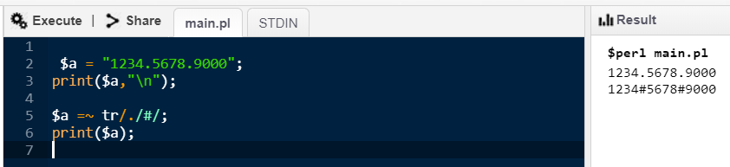

Slide 55
Replace a particular character in a string
$a = "ATCGATCGAAAAAAAA";
print($a,"\n");
$a =~ tr/A/C/;
print($a);

Slide 56
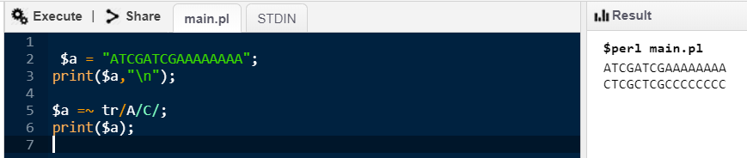

Slide 57
Replace more than one character
$a = "ATGGTTATAT";
print ($a,"\n");
$a =~ tr/AT/CZ/;
print $a;

Slide 58
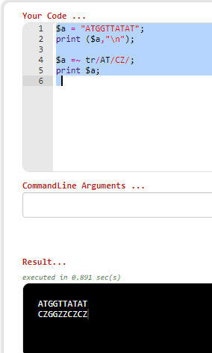

Slide 59
To extract characters from string
$string = "asdf";
@chars = map substr( $string, $_, 1), 0 .. length($string) -1;
print "First char is: " . $chars[0] . "\n";
$a=0;
while( $a < (length($string)) ) {
print $chars[$a],"\n";
$a = $a + 1;
}
exit 0;

Slide 60
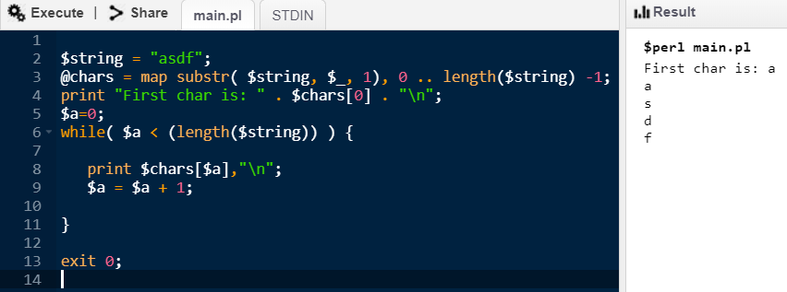

Slide 61
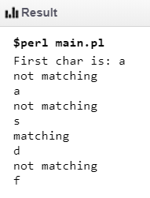
To search for a matching character
$string = "asdf";
$str2="d";
@chars = map substr( $string, $_, 1), 0 .. length($string) -1;
print "First char is: " . $chars[0] . "\n";
$a=0;
while( $a < (length($string)) ) {
if ($chars[$a] eq $str2)
{
print "matching \n";}
else
{print "not matching \n";}
print $chars[$a],"\n";
$a = $a + 1;
}
exit 0;

Slide 62
Replacing a specific character in a string
$string = "asdf";
$str2="d";
@chars = map substr( $string, $_, 1), 0 .. length($string) -1;
#substr($string,$_,1) means that each character is separated, if the 1 is changed to 2, the two characters are separated
print "First char is: " . $chars[0] . "\n";
$a=0;
while( $a < (length($string)) ) {
if ($chars[$a] eq $str2)
{ $chars[$a]="z"; print "matching \n";
}
else
{print "not matching \n";}
print $chars[$a],"\n"; $a = $a + 1; }

